Slide 1
ARIA OPERATIONS
Experience Day
KATE RYCHLIK and BENGT GRØNÅS
Senior MultiCloud Management Specialist Solution Architects
Tuesday, 26 September 2023

Slide 2

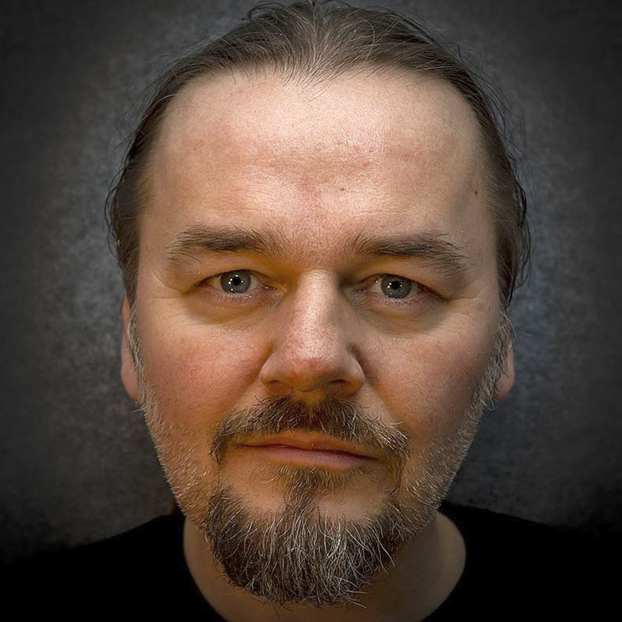


Introduction
BENGT GRØNÅS Senior MultiCloud Management Specialist Solution Architect 8+ years in VMware Based in Oslo, Norway Covers Nordics and Baltics Often a Lab Captain at Vmware Explore / VMworld Music production, long travels; hiking, motorcycle, chess @bgronas
KATE RYCHLIK Aka. Kasia, Katia, etc Senior MultiCloud Management Specialist Solution Architect 2+ years in VMware Based in Amsterdam, Netherland Covers Benelux Race cars, DIY, skiing, cooking & baking @krychlik
Notes:
Here we are

Slide 3
Challenges with Operations Management
Includes optimizing processes and ensuring staff availability & skills
Meet SLAs
Modernize
Visibility
Manage Costs
Manage Risk
Deliver performance to meet business needs
Better use existing resources
Troubleshoot to make quick decisions
Licensing, CAPEX, OPEX
Stay compliant and secure
Notes:
CHALLENGES IN OPERATIONS MANAGEMENT:
Complexity and siloed processes.
Need to meet SLAs cost-effectively.
Modernization and resource optimization.
Unified visibility for quick decision-making.
Cost reduction amid container growth.
Managing risk and compliance.
Transition: Aria Operations can simplify your cloud journey, whether private, hybrid, or multi-cloud.

Slide 4
VMware Cloud Operating Model Tenets
Powered by VMware Cloud Management
VMware Cloud Operating Model
Process
Delivery
Performance
Build VMware Clouds
Embrace Multi-Cloud
Cost
Transform ITOps
Cloud experience out-of-the-box
Align CloudOps
Unified management across multiple clouds
Security
Notes:
A cloud operating model consists of 3 competencies:
Service Delivery
Operations
Governance
A cloud operating model should be able to up-level your existing virtual environments to a fully functioning self-service cloud, and
bring consistency in delivery, operations, and governance to multi-clouds.
It should incorporate a set of processes and capabilities that efficiently extend these capabilities to additional clouds or environments
through a repeatable, extensible on-boarding process.

Slide 5


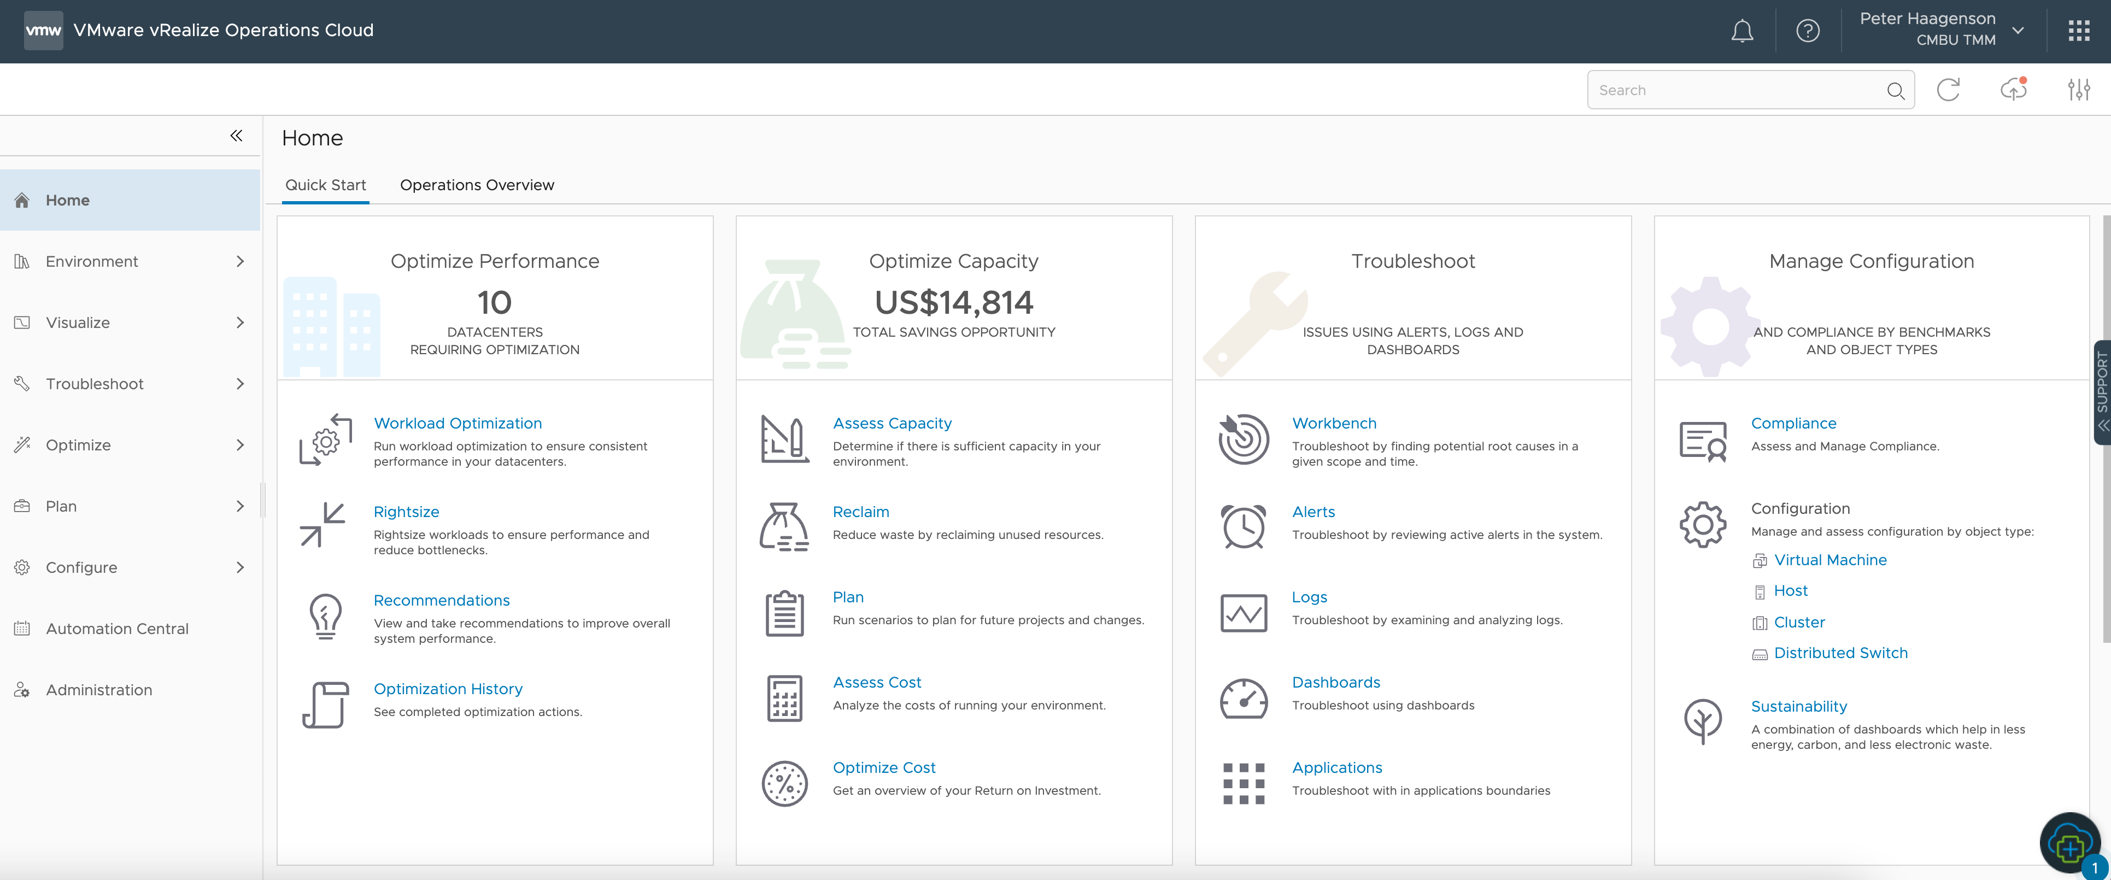






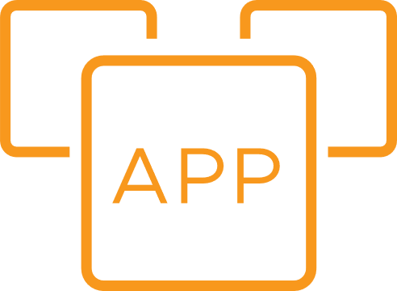
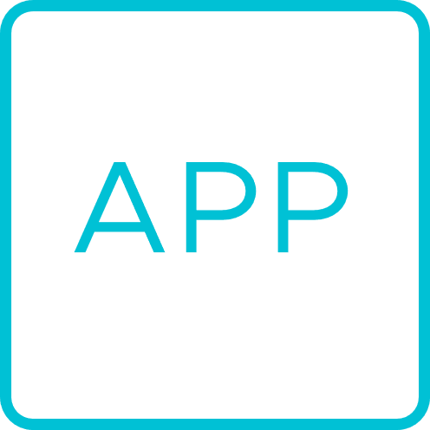
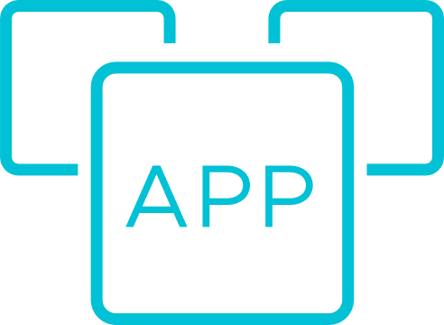
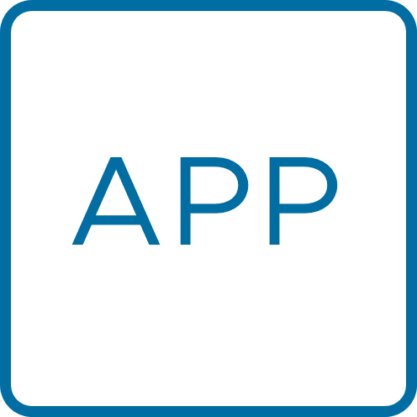

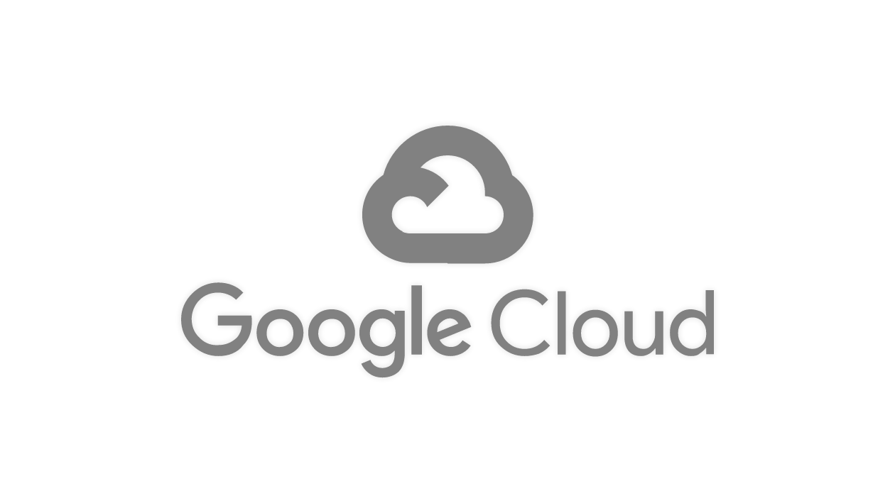
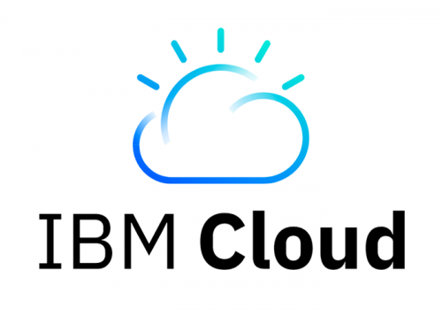
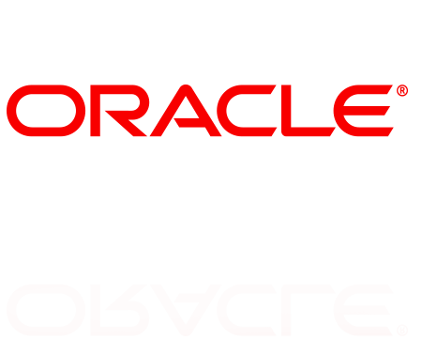
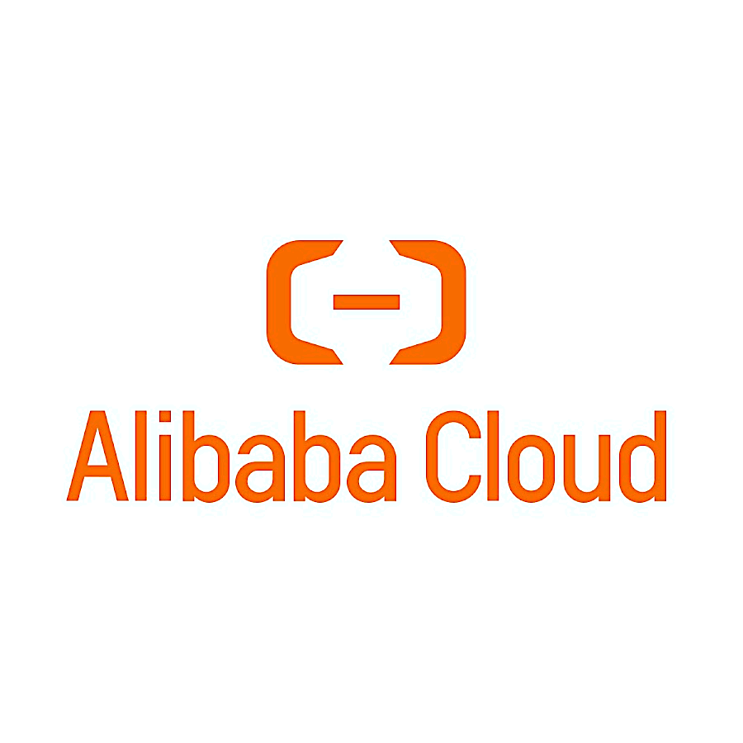
Operations
Applications
Alerts
Application Teams
VMware Cloud
Containers
Visualize
SRE / DevOps
VMware Cloud Foundation
Edge
Troubleshoot
Cloud Operators
Public Cloud
Partners
Predict Automate
Infrastructure Teams
End Points
Unified Ops Platform
---
Powered by AI
Performance Optimization
Capacity & Cost Optimization
Compliance Configuration
Intelligence Remediation
Operational Decisions
Cloud Resources Accounts | Users | Assets | Config | Apps | …
Microsoft
Azure
VCF
VMware Cloud on Dell
VMware Cloud on AWS
Azure VMware Solution
Google Cloud VMware Engine
IBM Cloud for
VMware Solutions
Oracle Cloud VMware Solution
Alibaba Cloud VMware Solution
Public Clouds
Notes:
: Providing Performance, Optimization & Resilience
- Show all VMware Cloud logos below Ensemble box
Add hyperscalers to the right, indicating [exiting] cloud management outside of Ensemble
Show bi-dir data paths, benefits for all investments
In addition to vRCU, we also have built another offering called VMware vCloud Suite Subscription.
vCloud Suite Subscription is a new subscription-based version of vCloud Suite, which combines VMware vSphere ENT+ server virtualization platform with VMware vRealize Cloud for cloud infrastructure management.
A key thing to note is that only the vRCU portion has the ability to “flex” between on-premises and SaaS management. The vSphere component of this offering is a subscription-based term license and is only available as on-prem.

Slide 6

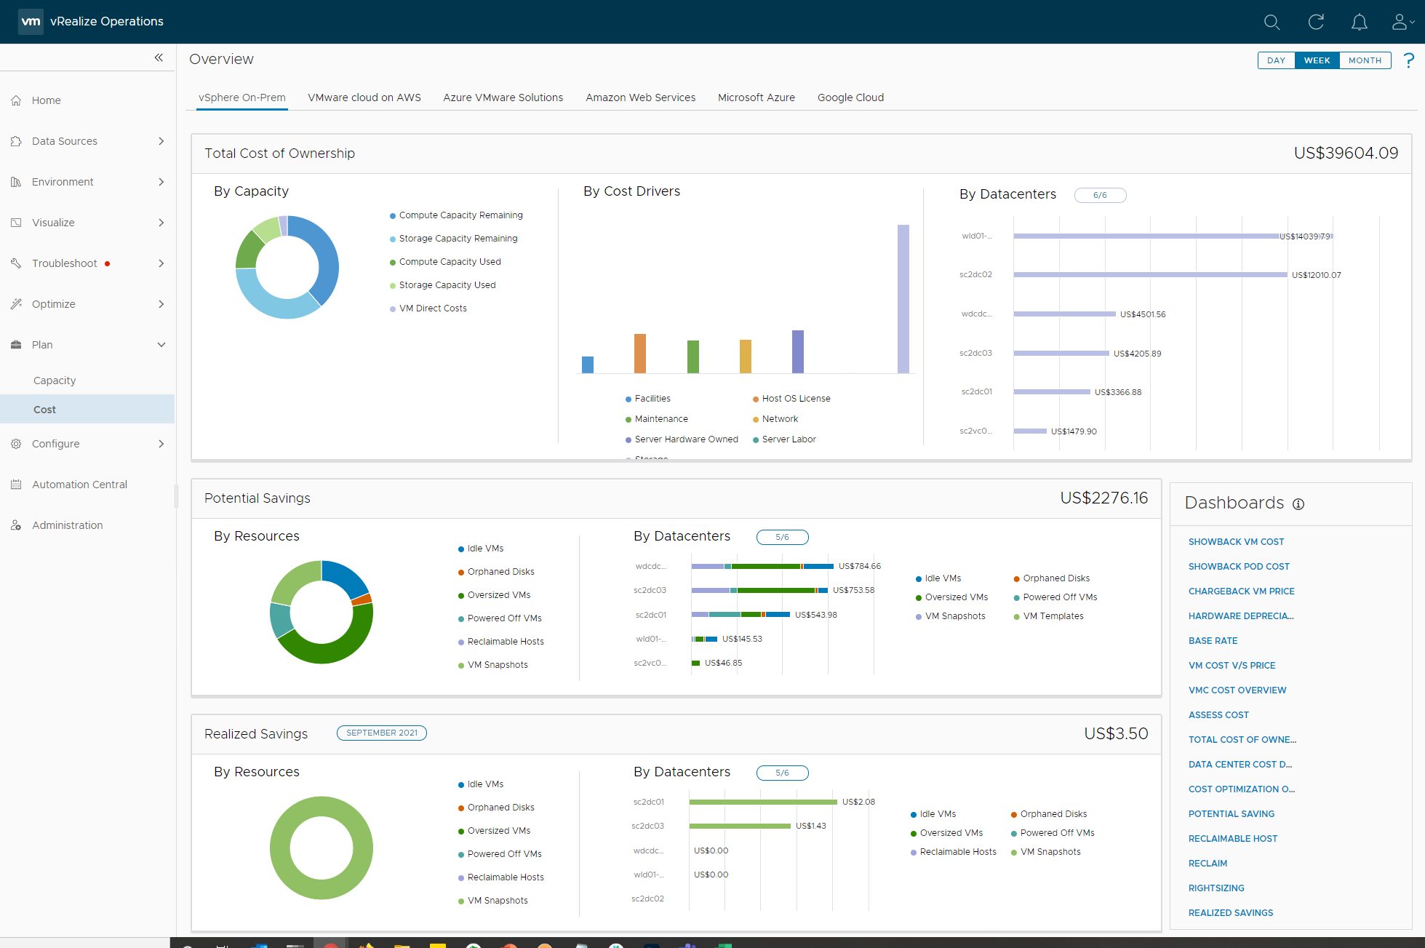
Cost
Cost Dashboard
Key Capabilities
Detailed Cost Analytics
IT Finance
Showback & Reporting
Cloud Operations
Procurement Planning
Migration Assessment
Infrastructure Teams
Public Cloud Cost Integration
Cloud Resources Accounts | Users | Assets | Config | Apps | …
Microsoft
Azure
VCF
VMware Cloud on Dell
VMware Cloud on AWS
Azure VMware Solution
Google Cloud VMware Engine
IBM Cloud for
VMware Solutions
Oracle Cloud VMware Solution
Alibaba Cloud VMware Solution
Public Clouds
Notes:
: Report on and Optimize on Cloud and Apps

Slide 7

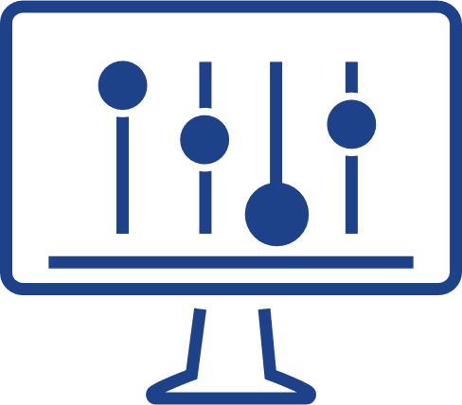

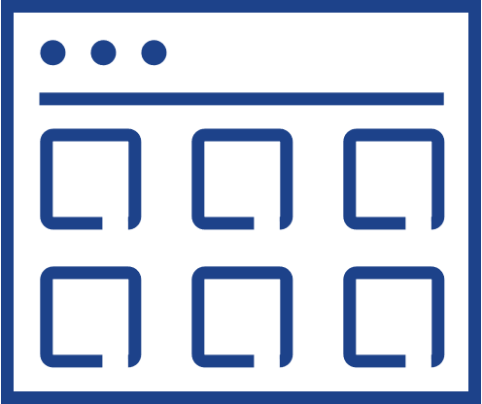
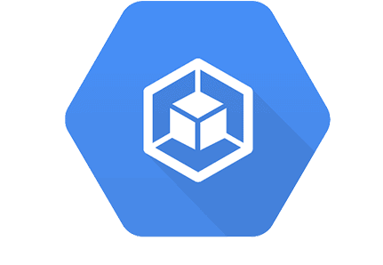
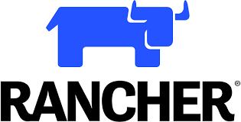
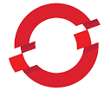
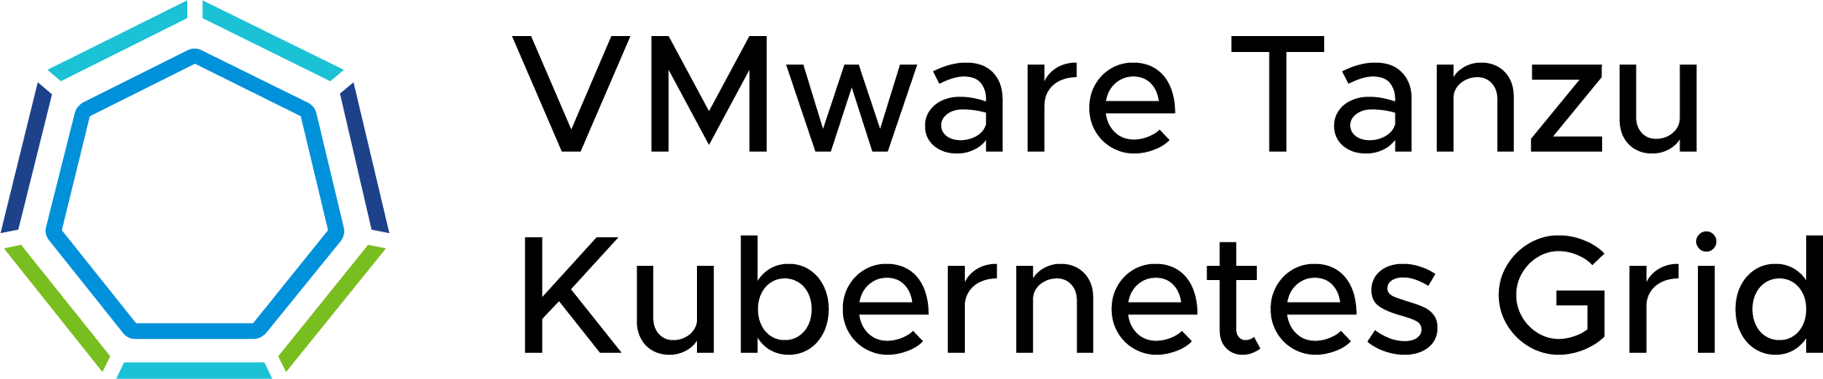
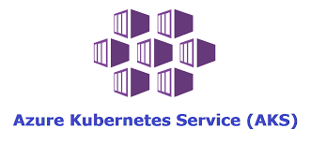
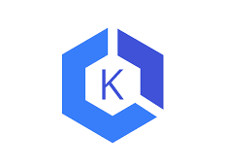

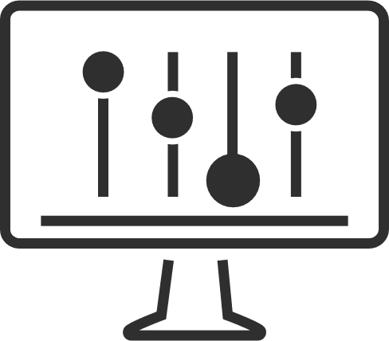

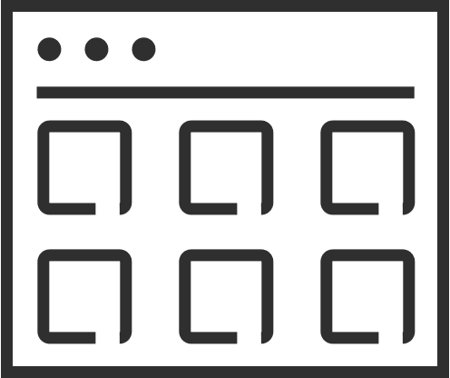
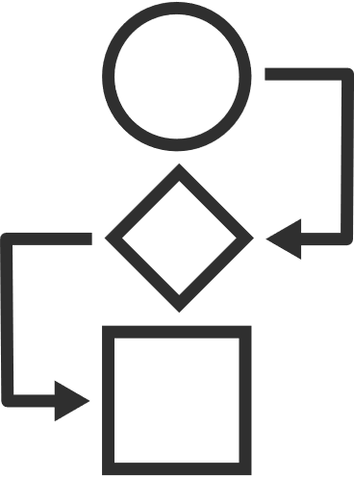





What does good look like?
The Cloud Operating Model
App strategy
Retain
Rehost
Replatform
Refactor
Retire
CLOUD OPERATING MODEL
2. MANAGE ACROSS CLOUDS
VMware multi-cloud management
Cost
Performance
Secure Config
Delivery
Kubernetes runtime and management
1. BUILD CLOUDS
VMware Cloud
Public Cloud
Cost
Performance
Secure Config
Delivery
Cost
Performance
Secure Config
Delivery
IAAS CAAS PAAS
IAAS CAAS PAAS
VMware multi-cloud management
PRIVATE CLOUDS
PARTNER CLOUDS
SOVEREIGN CLOUDS
TELCO CLOUDS
EDGE CLOUDS
EDGE
VMware infrastructure
Notes:
Multi-Cloud Transformation Success
Define an app strategy for both new and existing applications.
Consider retention, rehosting, replatforming, refactoring, or retiring apps.
Embrace diverse app types, including traditional, Kubernetes-based, cloud-native, and SaaS.
Efficiently manage multi-cloud environments with the right technology, processes, and people.
Cloud Operating Models
Native public clouds offer self-service IaaS and PaaS services.
VMware Cloud replicates the native public cloud experience.
VMware Aria Management facilitates setup, service delivery, cost, and security management.
Tanzu Mission Control extends Kubernetes management to multiple clouds.
VMware Aria provides end-to-end solutions for infrastructure and cloud-native app management.
Cloud Management Challenges
Managing multi-cloud and multi-technology environments is complex.
Control costs, ensure performance, and maintain consistent security policies.
VMware Aria addresses cost, performance, configuration, and delivery management.
It enables cost optimization, security policies, and performance management.
Offers financial and performance management, security, and delivery automation for developers.
Cloud Operating Model Benefits
A holistic Cloud Operating Model combines people, processes, and technology.
Promises impressive results like reduced cloud spend, increased productivity, fewer misconfigurations, decreased downtime, and lower software costs.
VMware offers capabilities to handle complex multi-cloud realities.
Transition: Aria’s comprehensive solutions Achieve multi-cloud transformation successes.
Embrace the Cloud Operating Model for noteable results.

Slide 8
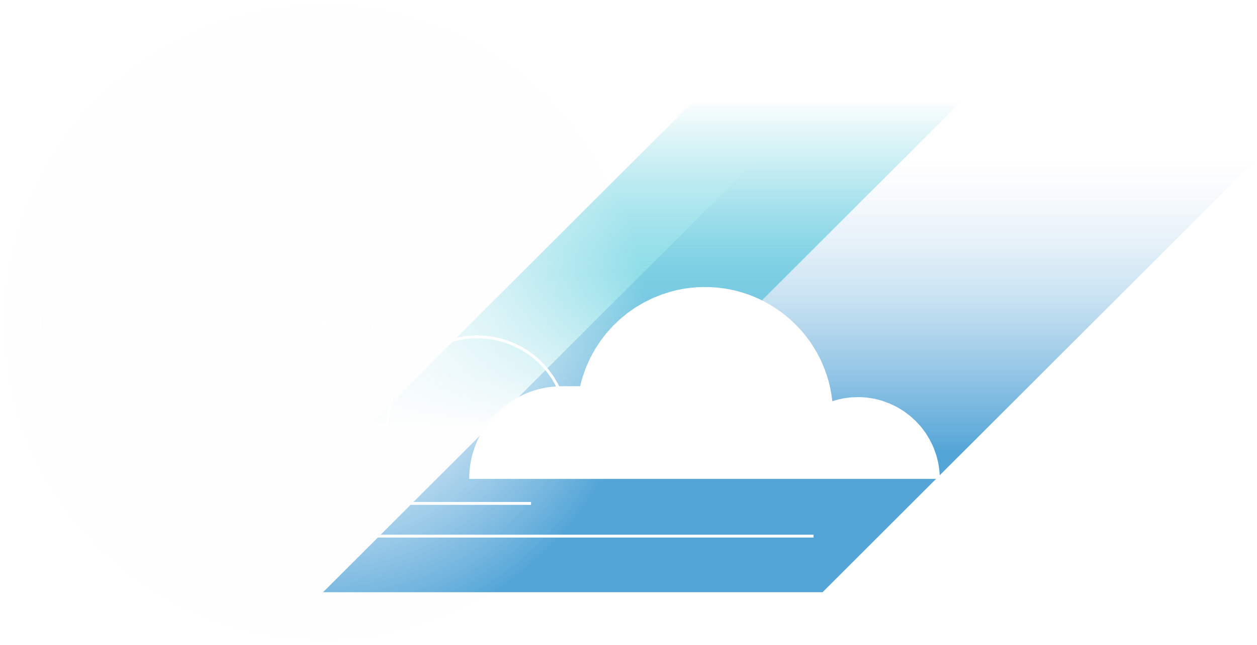

vRealize Operations Clouds capabilities
Powered by AI, from apps to infra, multiple clouds, on-premises or SaaS
Continuous Performance Optimization
Integrated Configuration and Compliance
Efficient Capacity & Cost Management
Unified Ops Platform
Powered by AI
Application monitoring and Intelligent Remediation
Notes:
What is Aria Operations used for with our customers?
Capacity Planning and Adjustments
Critical Troubleshooting
App & OS Monitoring
Cost Planning and Management
TCO & ROI
Workload Optimization
Reporting Automation
Leveraging vSphere Tagging
Operationalizing VCF
To Maintain efficient operations
Enable governance and consistency
Continuous Performance Optimization
Reduce downtime with automatic workload balancing.
Real-time AI analytics optimize performance.
Efficient Capacity & Cost Management
Run infrastructure like a public cloud.
Predictive analytics identify capacity risks.
Intelligent Remediation
Predict, prevent, and troubleshoot across clouds.
Integrated Configuration and Compliance
Manage IT and regulatory standards effortlessly.

Slide 9

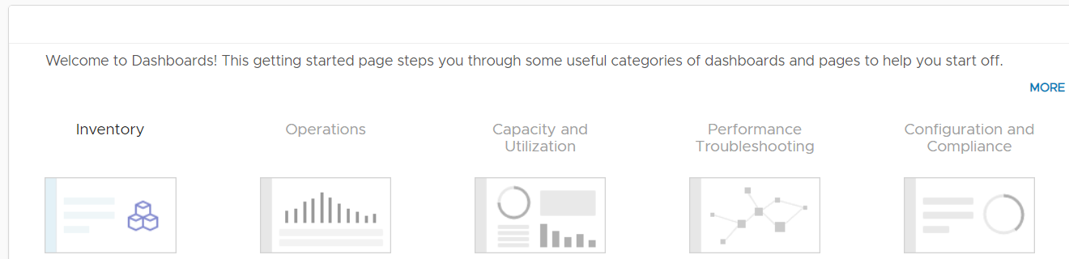
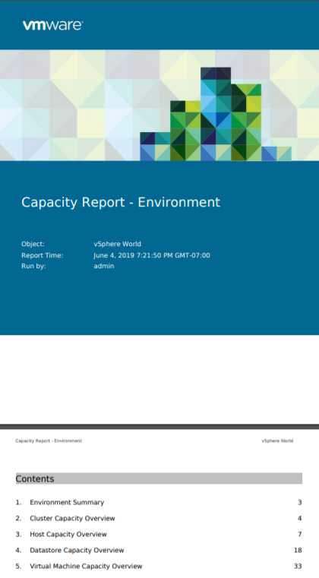
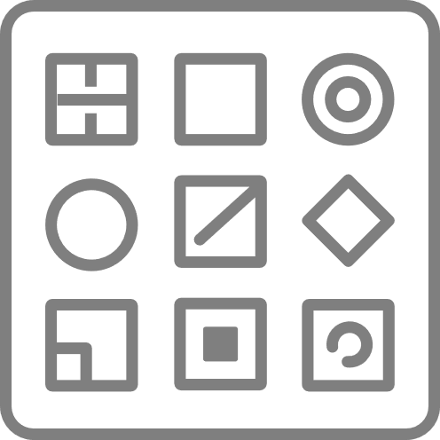
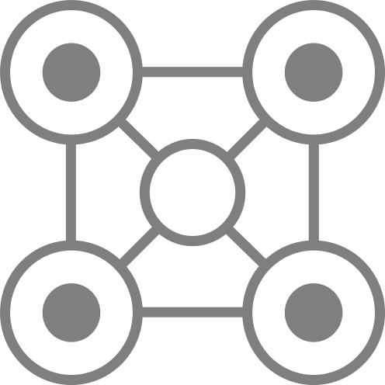
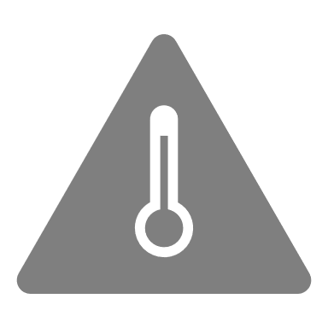

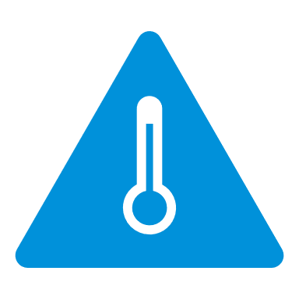
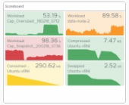
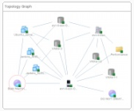
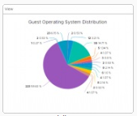
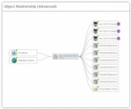
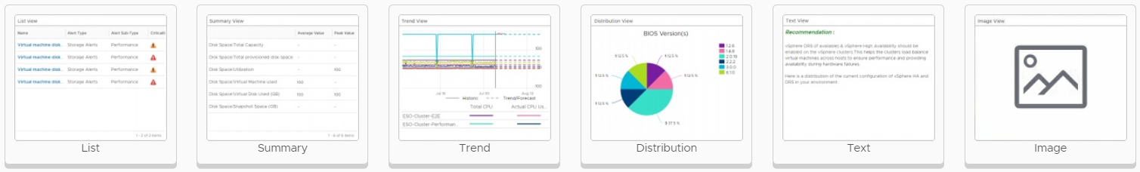

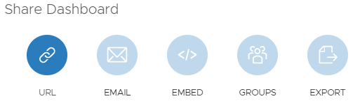



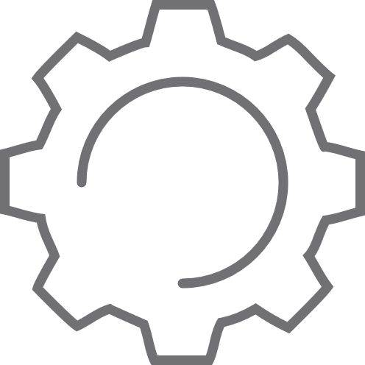
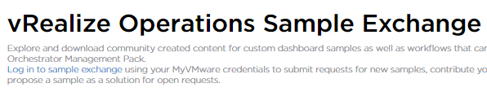

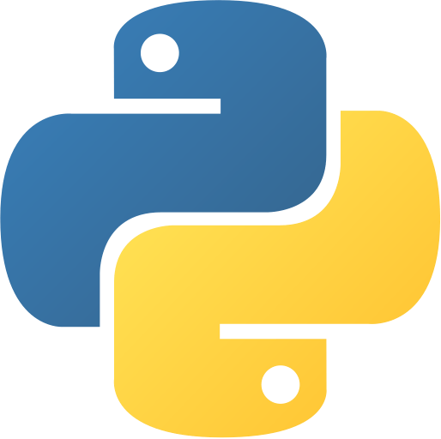



Enhanced visibility with predictive alerts, dashboard and reports
Increase monitoring efficiency with key operational tools
ALERTS
DASHBOARDS
REPORTS
Alert Definitions
Dashboards
Report Templates
50+ Out of box report templates covering multiple use cases
Inventory
Configuration
Compliance
Capacity
Utilization
Performance
Impacted Objects
Impact Type
Correlated Symptoms
Recommendations & Actions
Helps visualize data through out of box and custom dashboards
Optimization
Other Solutions
Custom
Symptoms
Widgets & Views
PDF | CSV
Data Transformation
Events
Configs
Metrics
Rest
40+ Interactive Widgets & 100+ customized views with data transformation capabilities
Multiple views for excel like capabilities to transform data and present them within report templates
Recommendations
Dashboard Sharing
Report Sharing
KB Articles
Actions
Custom
Dashboard sharing with internal & external teams
Manual
Report Generation
Scheduled
Curated Python Actions
Curated/Custom vRO Workflows
Rest API
API
Actions
Community curated dashboard samples through GitHub
Email
Report Sharing
Network Share
API
Rest API
Notes:
Recommendations>Actions
Dashboard sharing and code.vmware.com
Reports > management!

Slide 10
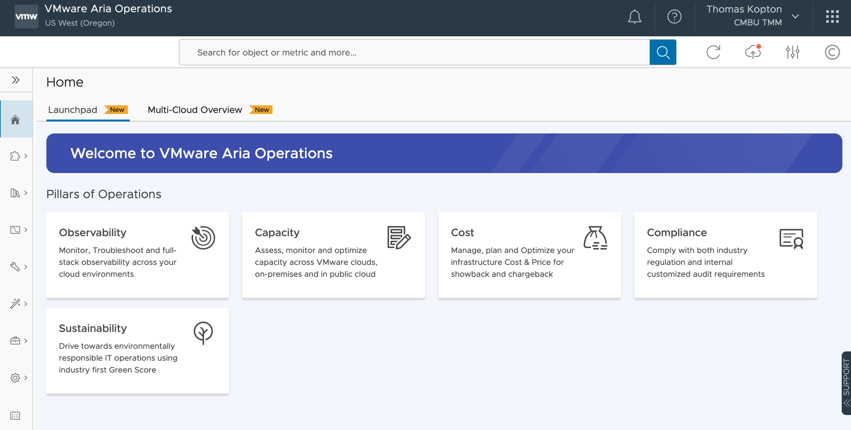
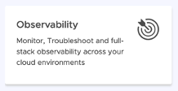
Performance and Troubleshooting

Slide 11
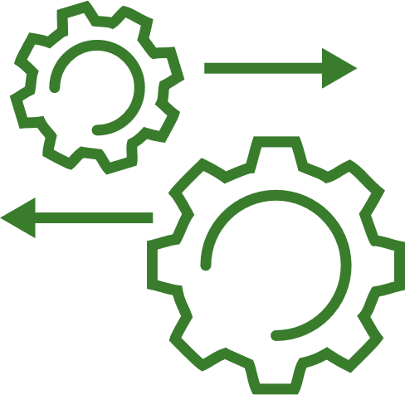
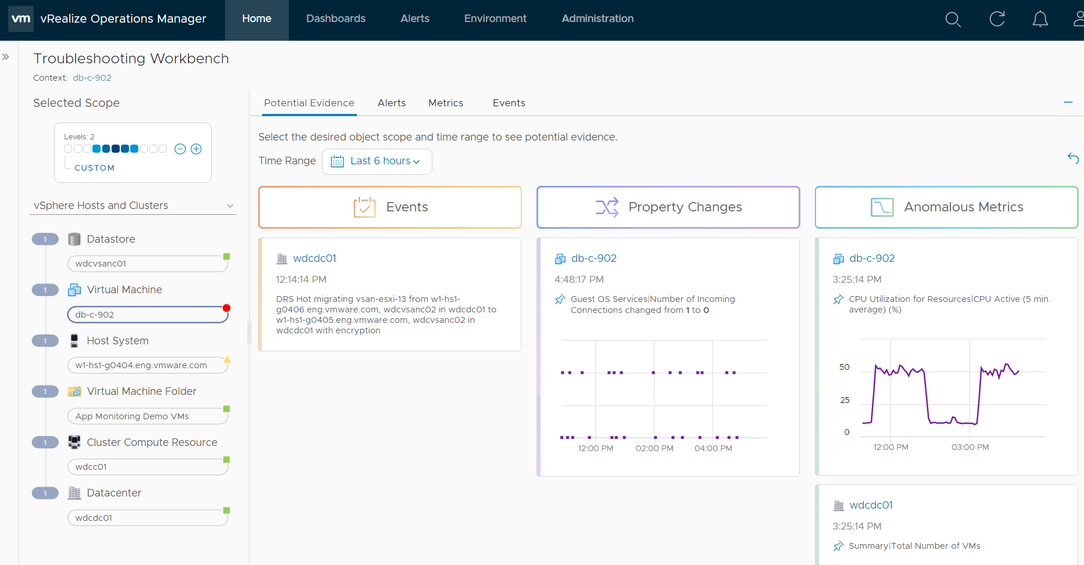
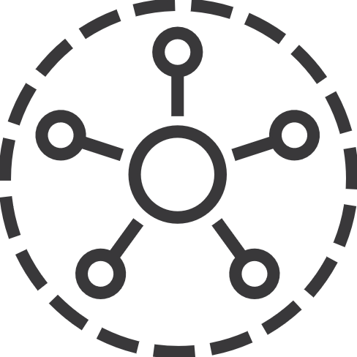


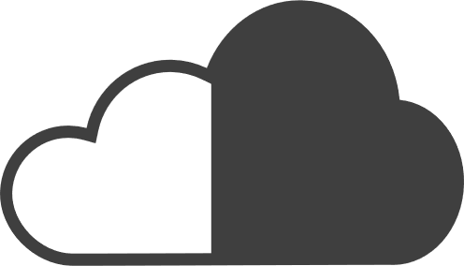
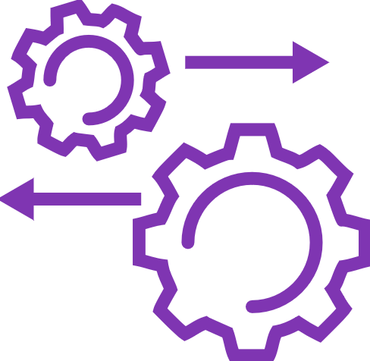
Intelligent monitoring and root cause analysis
Anomaly detection and root cause analysis
Dynamic time range to define problem scope
Finds potential root cause across with Events, Config Changes and Anomalous Metrics
Monitoring & Troubleshooting
Ecosystem integrations for a unified view from apps to infrastructure.
Predictive alerts with multi symptom correlation across metrics, events and logs.
Troubleshooting workbench with predictive root cause analysis using anomaly detection and correlation algorithms.
Complete visibility into Private and Public cloud resources in a single pane of glass
Dynamic full stack topology to define problem scope
AI/ML Engine Root Cause Recommendations

Slide 12
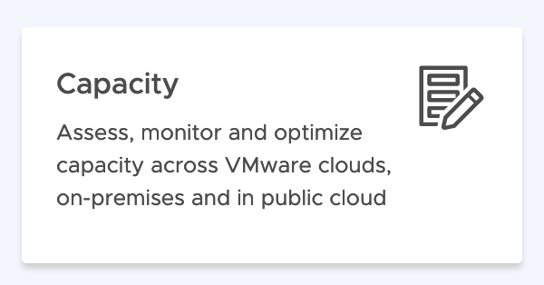
Capacity Management

Slide 13
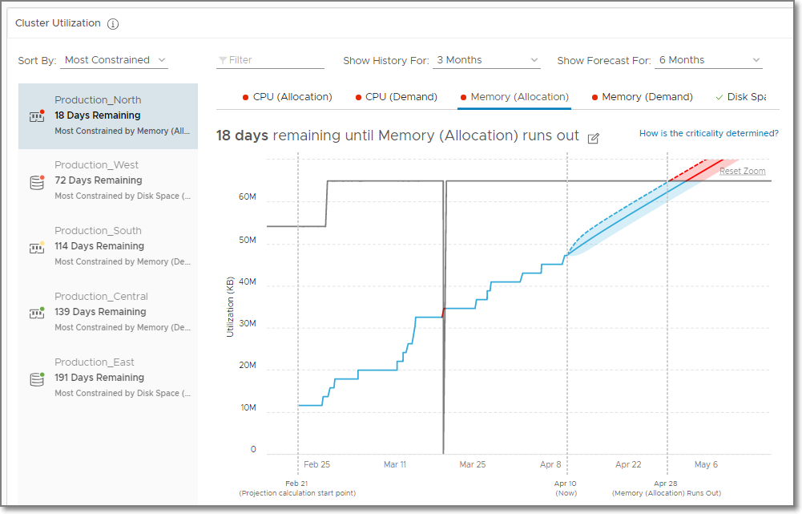
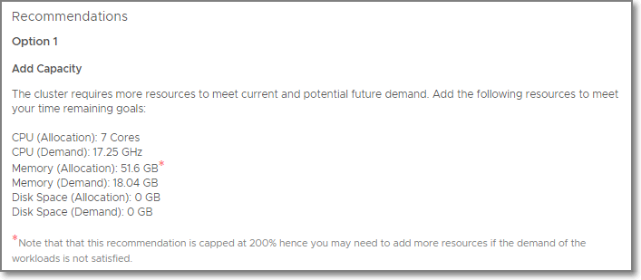
Assess Capacity, Predict Demand, and get Recommendations
Assess Capacity based on Demand and Allocation (Optional)
Assess Overall Capacity: Single view of the world
Capacity Projection: View current utilization and projection per resource (CPU, Memory, and Disk Space)
Get recommendations
Reclaim unused capacity
Add capacity in private cloud
Run what-if scenario to migrate to public cloud
Projected Utilization
Notes:
Aria operations capacity analysisys in based on “Forward-Looking” Analytics Engine, that is capable to provide Real-Time Predictive Capacity Analytics.
It’s based on industry-standard statistical analysis model of demand behavior

Slide 14
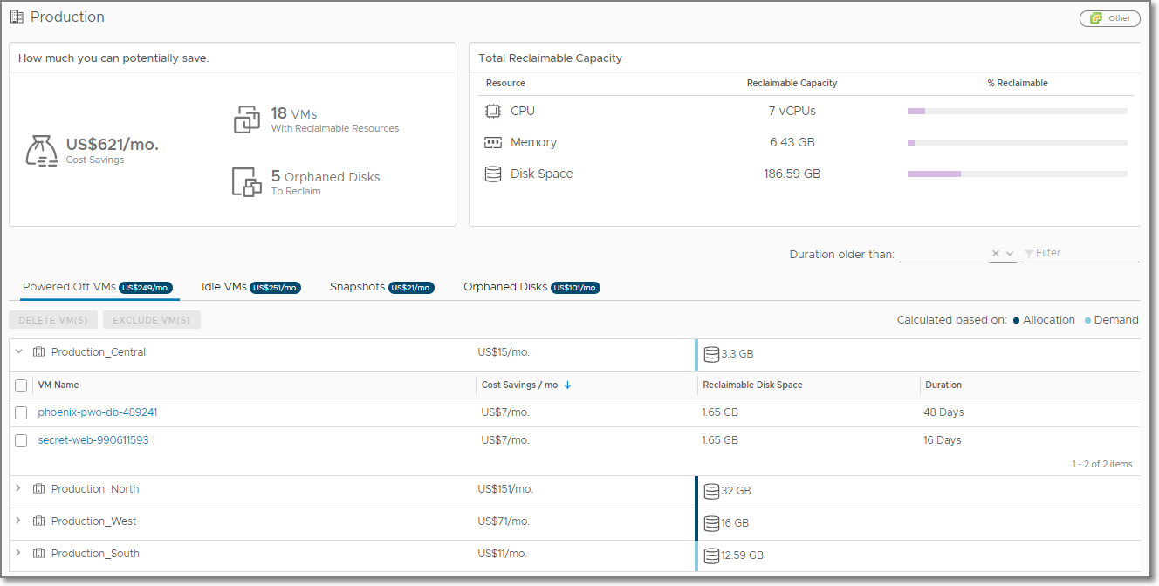
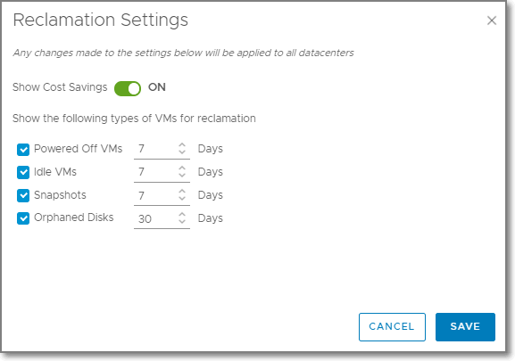
Reclaim Capacity and Automate Cost Savings
Define Business Intent for Reclamation:
Turn on or off cost savings on this dashboard.
Specify your desired time requirements for reclamation
Powered Off VMs
VMs that have been continuously powered off during the defined period of time
Idle VMs
VMs that have used no more than 100MHz CPU during the defined period of time
Snapshots
VM snapshots that have existed for the entire defined period of time
Orphaned Disks
VMDKs on datastores that aren’t connected to any registered VMs and have not been modified during the defined period of time
How long before VMs get flagged as Reclaimable

Slide 15

Workload Optimization – Simplified Rightsizing
Because moving VMs can’t solve all your performance problems!
Rightsizing UI
Oversized and Undersized
Launched from Optimize Performance left panel
Uses the CDC header for context
Notes:
Recommended Size is generated by the capacity engine, but it is artificially capped by VMware Aria Operations to keep the recommendations conservative
Oversized Recommended Size is capped at 50% of the currently allocated resources
Oversized Example:
A VM is configured with 8 vCPUs and historically has never used more than 10% CPU. Instead of recommending reclaiming 7 vCPUs, the recommendation is capped to reclaiming 4 vCPUs.
Undersized Recommended Size is capped at 100% of the currently allocated resource
Undersized Example:
A VM is configured with 4 vCPUs and historically has been constantly running very hot. Instead of recommending adding 8 vCPUs, the recommendation is capped at adding 4 vCPUs.

Slide 16



















Plan for future needs and datacenter migration scenarios
Plan and stack multiple scenarios to arrive at accurate capacity decisions
Capacity Planning Scenarios
CHOOSE SCENARIOS
Onboarding new workloads
Workload Planning
Physical Infra Planning
HCI Planning
Cloud Planning
Decommission existing workloads
DEFINE SCENARIOS
Server procurement planning (includes HCI)
Decommission existing servers
Server hardware refresh
STACK SCENARIOS
Hybrid cloud migration
Public cloud cost comparison
VISUALIZE OUTCOMES

Slide 17


What-If: Stacked Scenarios
Plan complex situations, stack multiple What-If Scenarios together
Enables capacity planning for real-life business scenarios
Application Deployment
Application Retirement
Hardware Refresh
Decommission Hosts
Supported Stacked Scenarios
Add/Remove Workload + Add/Remove Hardware
Add/Remove Workload + Add HCI Node

Slide 18

Cost Management

Slide 19



Assess Overall Costs of Running Your Environment
What’s my total Cost?
Total Cost of Ownership: View the total cost of the private cloud environment
Cluster Costs: What’s the cost of each of the clusters. List of clusters by the most expensive and least expensive
Datastore Costs: What’s the number and cost of the datastores in each of my datastores
Customize Cost Drivers: Adjust cost drivers to match your actual costs
View Costs from Infrastructure to VMs
Showback: Create dashboards or reports to show VM cost
Notes:
Recommendation on hardware procurement: Based on the hardware footprint, recommendations on number of servers, blades to be procured along with cost
Potential Impact of adding new capacity: Impact on capacity and time remaining if new hardware is added to the clusters

Slide 20
Virtual Machine Cost
Storage
Datastore
Server Hardware: Hyper-Converged
Base Rate
Server Hardware: Traditional
Datacenter
(Non-Clustered Hosts)
Facilities
Network
Host System
Additional Cost
Cluster Compute Resource
vCenter
Host
Virtual Machine
Base Rate
Labor
Server
Virtual Infrastructure
Operating System
Maintenance
Virtual Machine
Hardware
Direct Cost
Operating System
License
Hypervisor
Guest OS
Applications

Slide 21

Application monitoring
Notes:
OS too !!!!!

Slide 22
























Open source telegraf support
Self-Service data collection supporting 200+ applications
sudo dnf -y install telegraf
Input Plugins
Cloud proxy
Notes:
ANY OS, NOT JUST VIRTUAL

Slide 23

Application monitoring
Through the Telegraf Agent
Notes:
Application Monitoring
Application monitoring can be performed through the Telegraf Agent.
If we want to extend to applications that we do not support out of the box, we can leverage the open source Telegraf Agent that runs on a vCenter Server VM, an EC2 AWS instance, or an Azure VM to send metrics to vRealize Operations.
We can configure the open source Telegraf on a Linux platform or on a Windows platform.
We can monitor operating systems, conduct remote checks, and monitor Windows services and Linux processes. Note: The Open Source Telegraf agent can also run on Physical servers.
The Couchbase application (a distributed multi-model NoSQL database) is not supported out of the box. We have the open source Talegraf agent installed on a VM called Couchdb01. Click the Search Field.
Select the virtual machine couchdb01 .
Click the Tab Metrics.
This looks just like any other virtual machine with the curated Telegraf agent, it is basically the same agent. We can see the Linux OS, and we can get the OS level metrics here, expand the Linux OS.
In addition to the OS level metrics, we can get the couchbase application metrics , Click couchbase.
Click Metrics.
Click bucket.
Click node.
As an example, to get information on how much memory is free from within this application, click memory_free.
VMware vRealize Operations Service and Application Discovery expands on the capability to help companies maintain performant applications to serve their business. Further information on Service and Application Discovery can be found in the VMware Documentation Center.
OS and Application monitoring enables us to discover operating systems and applications running in provisioned guest operating systems to ensure that the infrastructure provided for running the application services is sufficient and that there are no problems. We can view important metrics related to the applications and share the information with the team managing the applications.
Further information on Service and Application Discovery can be found in the OS and Application Monitoring in VMware Documentation Center
See the following topics:
Monitoring Application Services and Operating Systems using Open Source Telegraf
Monitoring Applications using Open Source Telegraf on a Linux Platform
Monitoring Applications using Open Source Telegraf on a Windows Platform
Sample Configurations
Configuring Cloud Proxies in AWS and Azure
Configuring Cloud Proxies in VMware Cloud

Slide 24
Integrations

Slide 25










Open Ecosystem Integrations
Skyline
Multi-Cloud
APMs
CMDB
Apps
Network Insight
Native Public Cloud
Custom Integrations
Automatiom
VMware Aria
Operations
VMware Aria Operations for:
Logs
Integration
Networks
Skyline
Logs
Physical Infrastructure
True VIsibility
Tanzu & Kubernetes
CloudHealth
CloudHealth
3rd Party
MP Designer
Management packs
Notes:
Attain data depth & context in a single view, with integrations

Slide 26

Integrations

Slide 27







Extending Operations
Aria Operations for Integrations. The True Visibility Suite
Aria Operations
Application-aware monitoring across SDDC and multiple clouds
Compute Chassis
Cloud planning, capacity optimization and compliance
Compute Blade
Storage Volume
Datastore
Automated and proactive workloads management
Compute Network
ESXi Host
VM
True Visibility Suite
Database Instance
Deeper root cause analysis
Database
Database Queries
Wider collaboration for hybrid cloud management
Network Switch
Full stack resource dependency mapping
Network Ports
Notes:
MARKETPLACE
CUSTOMER CONNECT

Slide 28

Compliance

Slide 29



VMware SDDC and Private Cloud Benchmarks
Measured against a set of standard rules, regulatory best practices, or custom alert definitions
vSphere Security Configuration Guide
vSAN Security Configuration Guide
NSX-T Security Configuration Guide
47 / 64 * 100 =73,4375%
Notes:
SDDC - HARDENING GUIDES
CIS - Center for Internet Security (CIS) Benchmarks
FIPS 140-2 = security requirements for cryptographic modules
https://www.cisecurity.org/cis-benchmarks/
DISA - Defense Information Systems Agency (DISA) Security Standards
Security Technical Implementation Guides (STIGs) / https://cyber.mil/
FISMA - The Federal Information Security Management Act (FISMA) Security Standards
NIST Risk Management Framework (RMF) / Federal Information Processing Standards (FIPS)
HIPAA Compliance - Health Insurance Portability and Accountability Act (HIPAA)
https://www.hhs.gov/hipaa
ISO - International Organization for Standardization (ISO) Security Standards
ISO standard (ISO 15408) = evaluation of Information Technology (IT) products. / ISO 27001 => Software Requirements for Compliance with ISO 27001 => VMware validated design
PCI - Payment Card Industry Data Security Standard (PCI DSS) compliance standards

Slide 30
Summary

Slide 31








Cloud Operating Model in Action
Powered by VMware Cloud Management
Provision, deploy, and manage infrastructure the same way on public and private cloud
VMware Cloud Operating Model
Reduced cloud spending by 40%, unified and on-demand visibility into activity across 62 environments in 12 countries
Cloud Strategy
Application Strategy
Financial Strategy
Technology
Process
People
Reduced monthly operating costs by 60% by discovering 30% less capacity needed in the cloud, reducing risk with rapid app and networking dependencies, and improving efficiency and simplicity for small staff
Digital Transformation
Automate provisioning, centralize management, and monitoring across customers to optimize IT spend across hybrid cloud
Reduced IT complexity with self-service automation supporting growth from 500 to 4K VMs with faster time to market and scale
Business Strategy
Visibility into unit cost by service to better predict, forecast costs, and optimize
for savings while also define and
maintain ideal state for governance
Saved 10 hours a month just on system upgrades and troubleshooting. Eliminated hardware lifecycle management with cloud-based ops
Hybrid cloud deployed in six months with a single pane of visibility and common management tools across
31
Notes:
IHS Markit
https://www.vmware.com/content/dam/digitalmarketing/vmware/en/pdf/customers/vmware-ihs-markit-customer-success-story.pdf
Provident Mexico – vRealize Suite Advanced, vRealize Network Insight, migrated to VMC on AWS
https://www.vmware.com/content/dam/digitalmarketing/vmware/en/pdf/customers/vmw-provident-mexico-en-case-study.pdf
Gfk
https://www.vmware.com/content/dam/digitalmarketing/vmware/en/pdf/customers/vmware-gfk-case-study-en.pdf
Borse Stuttgart – vROps Cloud
https://www.vmware.com/content/dam/digitalmarketing/vmware/en/pdf/customers/vmw-borse-stuttgart-en-success-story.pdf
------------
Discovery Limited insurance company – 6 people managing over 9K servers
https://www.vmware.com/content/dam/digitalmarketing/vmware/en/pdf/customers/vmw-discovery-holdings-v5.pdf
SAIC
https://www.vmware.com/content/dam/digitalmarketing/vmware/en/pdf/customers/vmware-saic-case-study.pdf
William Hill – CloudHealth, VMware Cloud on AWS, vSAN HCI
https://www.cloudhealthtech.com/resources/case-study/william-hill
888 Holdings
https://www.vmware.com/content/dam/digitalmarketing/vmware/en/pdf/customers/vmware-888-holdings.pdf
technology that enables customers to transform their traditional IT into Cloud Operations.
Embrace Multi-Cloud
Also, we empower organizations to embrace public cloud. Our customers are now used to consuming cloud services from public cloud providers. Cloud Operations still need to be able to manage and govern these cloud resources.
VMware makes it possible for IT organizations to embrace the way of multi-cloud and create a cloud operating model that has the ability to manage multiple clouds.

Slide 32






VMware Cloud Management Recognized by the Industry
#1 IDC Market Share
A LEADER in The Forrester Wave™
#1 OMDIA Universe
IDC IT Automation and Configuration Management Market Share
IDC WW Cloud Systems and Service Management Market Share
Forrester Hybrid Cloud Management Wave™
Forrester Infrastructure Automation Wave™
Forrester Cloud Cost Management and Optimization Wave™
OMDIA Selecting a Hybrid & Multicloud Management Solution
Source: IDC, Worldwide Cloud System and Service Management Software Market Shares, 2019: SaaS and ITOM Drive Growth, Doc #US45083420, May 2020Cloud Mgt Market Share
The Forrester WaveTM is copyrighted by Forrester Research, Inc. Forrester and Forrester WaveTM are trademarks of Forrester Research, Inc. The Forrester WaveTM is a graphical representation of Forrester’s call on a market and is plotted using a detailed spreadsheet with exposed scores, weightings, and comments. Forrester does not endorse any vendor, product, or service depicted in the Forrester WaveTM. Information is based on best available resources. Opinions reflect judgment at the time and are subject to change.
Forrester, Inc., The Forrester Wave™: Hybrid Cloud Management, Q4 2020, November 30, 2020
Forrester, Inc., The Forrester Wave™: Infrastructure Automation Platforms, Q3 2020, August 10, 2020
Forrester, Inc., The Forrester Wave™: Cloud Cost Management and Optimization, Q4 2020, October 28, 2020
Source: OMDIA Universe, Selecting a Hybrid and Multicloud Management Solution, 2020-2021Mgt Market Share
Source: IDC, Worldwide IT Automation and Configuration Management Software Market Shares, 2019: Market Expands Ahead of Coronavirus Impact, Doc# US46397520, June 2020
Notes:
VMware Aria cloud management is not only trusted by customers worldwide, but also recognized by industry analysts as #1 in market share by IDC, as a leader in the market by Forrester in these 3 Forrester Wave reports, and by OMDIA in the OMDIA Universe report.
Plus, VMware Aria was recognized by Gartner Peer Insights: Customers’ Choice Award: IT Infrastructure Monitoring Tools.
Transition: Let’s summarize this for you.

